Slide 2
Objective
This project deals with the operation of doubly fed induction generator (DFIG) with an integrated active filter capabilities using grid-side converter (GSC).
To mitigate load side harmonics and extract the maximum power.

Slide 3
CONTENTS
INTRODUCTION
CONVERTERS
DESIGN OF DFIG – BASED WECS
CONTROL ALGORTHM OF THE PROPOSED WECS
SIMULINK BLOCK DIAGRAM
SIMULATION RESULTS
CONCLUSION

Slide 4
INTRODUCTION
The increase in population and industrialization, the energy demand has increased significantly. The generation of power was really a challenge now a day. If we want to increase the power generated in the conventional way. However, the conventional energy sources such as coal, oil, and gas are limited in nature. Now there is a need for renewable energy sources for the future energy demand.
Due to technical advancements the cost of the wind power production is low comparable to that of conventional power plants.

Slide 5
RES preferred because of…….
Non-pollutant.
Naturally available.
Running cost less.
This system to generate sufficient energy to attend demand at accessible prices.
Provide clean, safe and reliable electricity.
eco- friendliness
Unlimited in nature

Slide 6
CONVERTERS
GRID SIDE CONVERTER(GSC):
It is for mitigating the harmonics produced by nonlinear loads.
ROTOR SIDE CONVERTER(RSC): The main purpose of RSC is to extract maximum power with independent control of active and reactive powers.

Slide 7
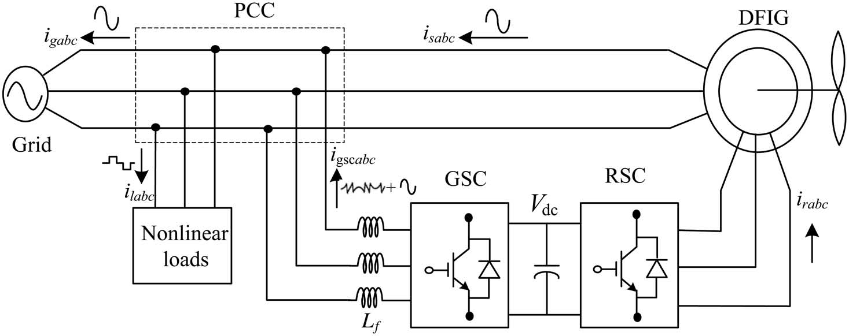
Design of DFIG – based WECS

Slide 8
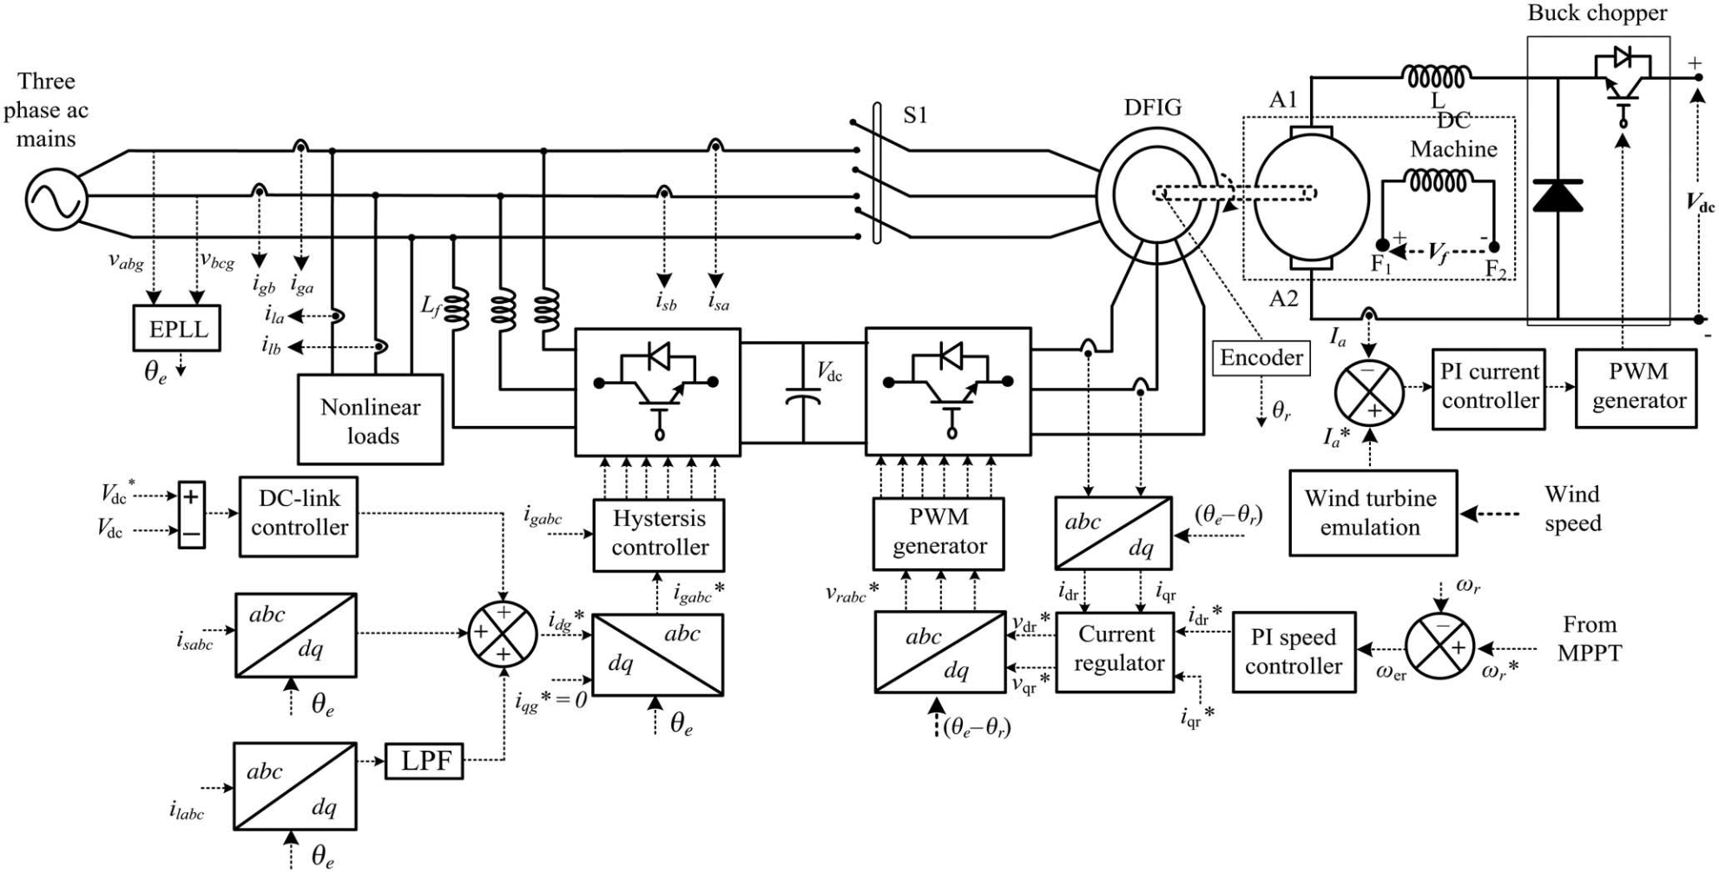
CONTROL ALGORTHM OF THE PROPOSED WECS

Slide 9
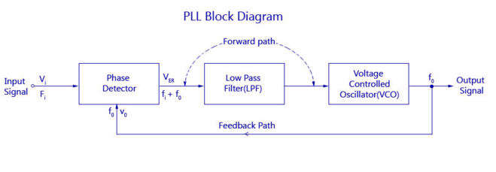
PHASE LOCKED LOOP
PLL basically consists of Three main parts
(a)phase detector
(b) LPF
(C) voltage controlled oscillator

Slide 10
Phase detector:
This comparator circuit compares the input frequency and the VCO output frequency and produces a dc voltage that is proportional to the phase difference between the two frequencies.
LPF:
A Low Pass Filter (LPF) is used in Phase Locked Loops (PLL) to get rid of the high frequency components in the output of the phase detector
It also removes the high frequency noise
It helps to control the dynamic characteristics of the whole system
Vco:
The main function of the VCO is to generate an output frequency that is directly proportional to the input voltage.
The frequency of oscillation is determined by the resistor R and capacitor C along with the voltage Vc applied to the control terminal.

Slide 11
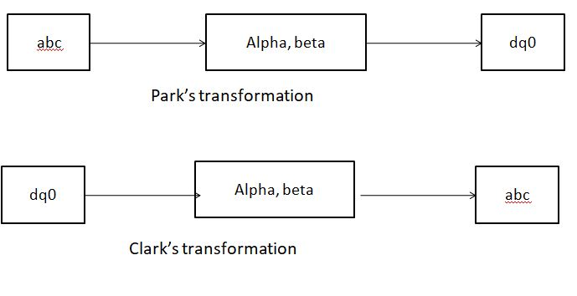
SYNCHRONOUS REFERENCE FRAME THEORY (D-Q THEORY):

Slide 12
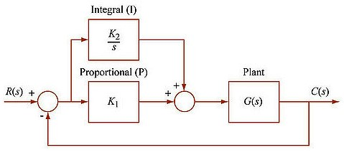
PI Controller

Slide 13
This is the combination of proportional and an integral controller the output (also called the actuating signal) is equal to the summation of proportional and integral of the error signal.
PI controller will eliminate forced oscillations and steady state error resulting in operation of on-off controller and P controller respectively.
The integral mode has a negative effect on speed of the response and overall stability of the system. Thus PI controller will not increase the speed of response.
PI controller does not have means to predict what will happen with the error in near future.

Slide 14
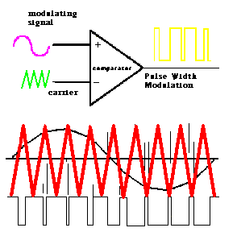
Pulse width modulation technique

Slide 15
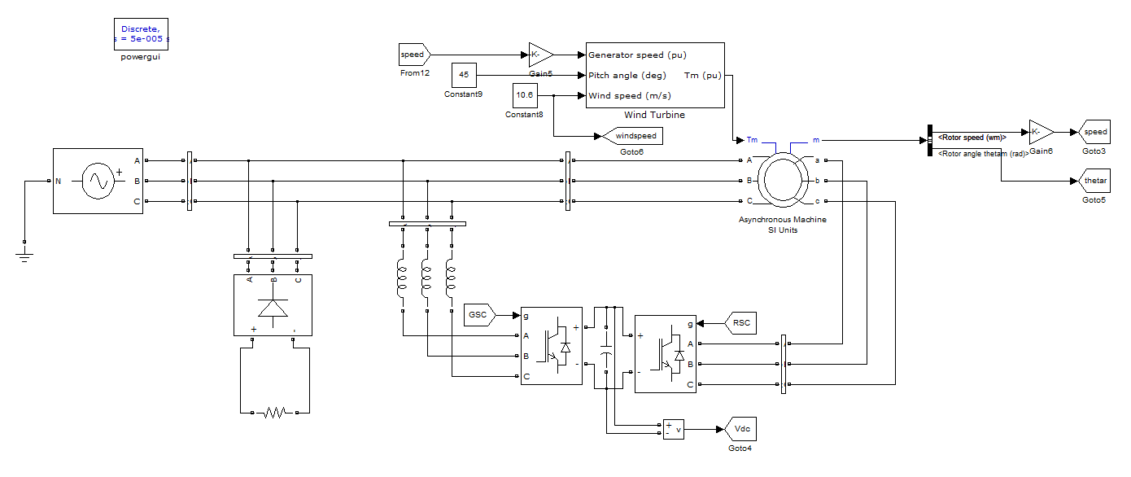
SIMULINK BLOCK DIAGRAM WITH PI CONTROLLER

Slide 16
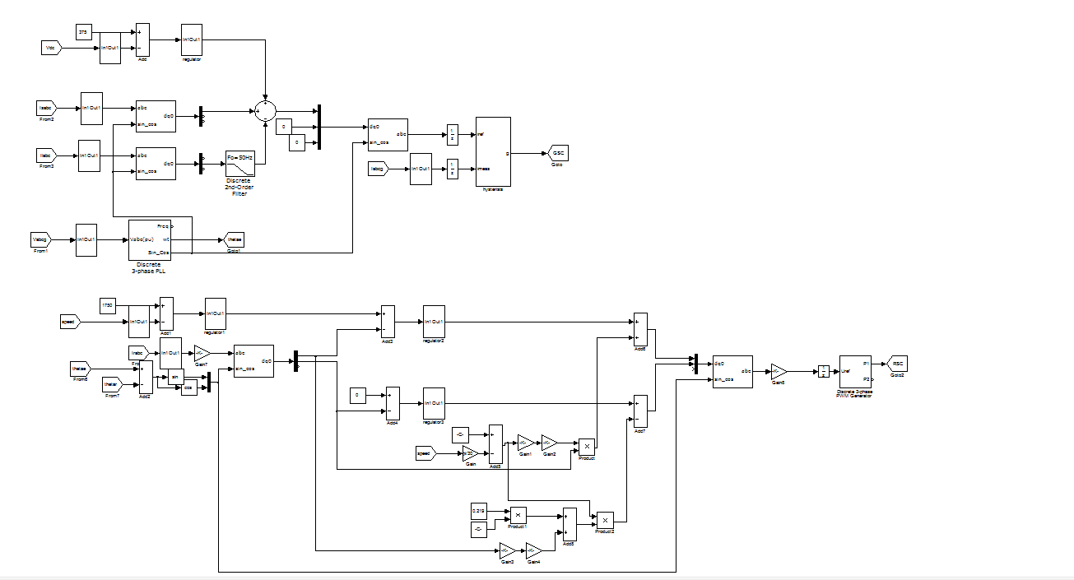
CONTROL BLOCK DIAGRAM FOR GSC AND RSC

Slide 17
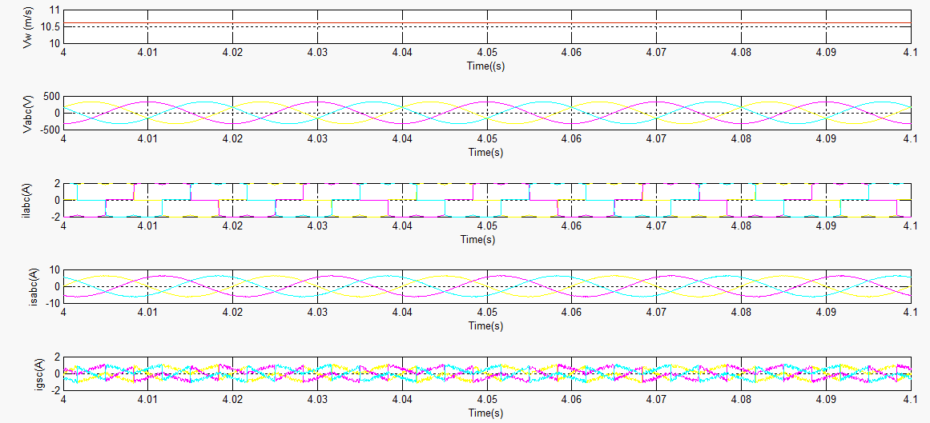
Simulated performance of the proposed DFIG-based WECS at fixed wind speed .

Slide 18
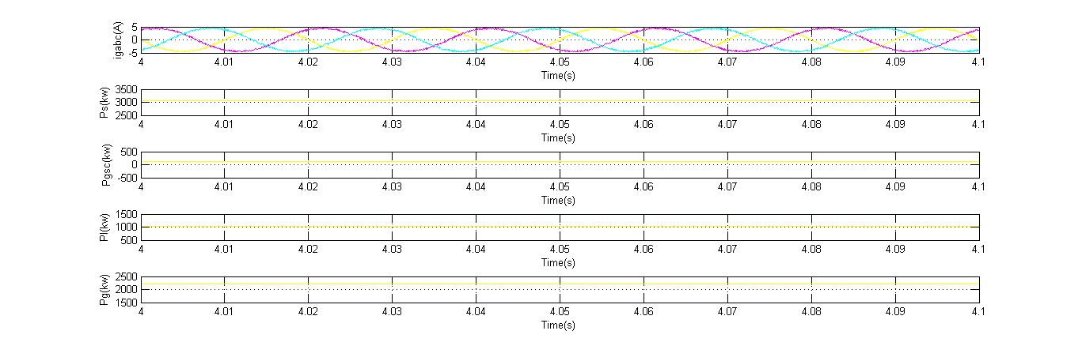

Slide 19
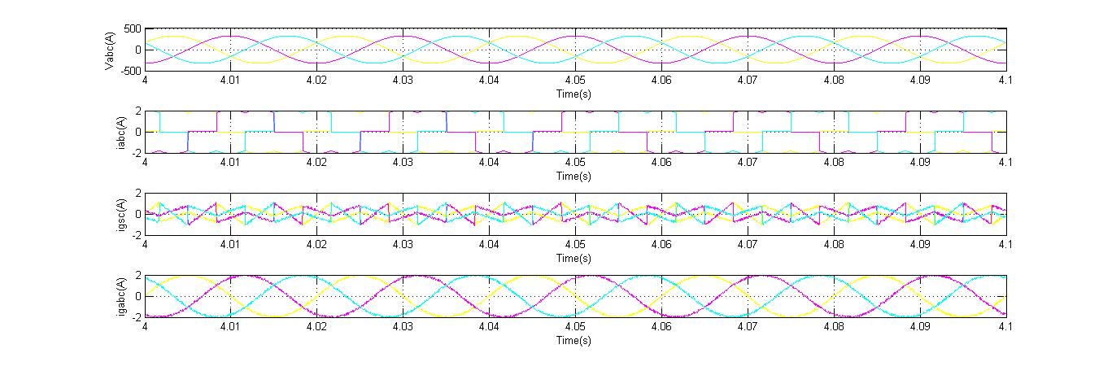
Simulated performance of the proposed DFIG-based WECS working as a STATCOM at zero wind speed.

Slide 20
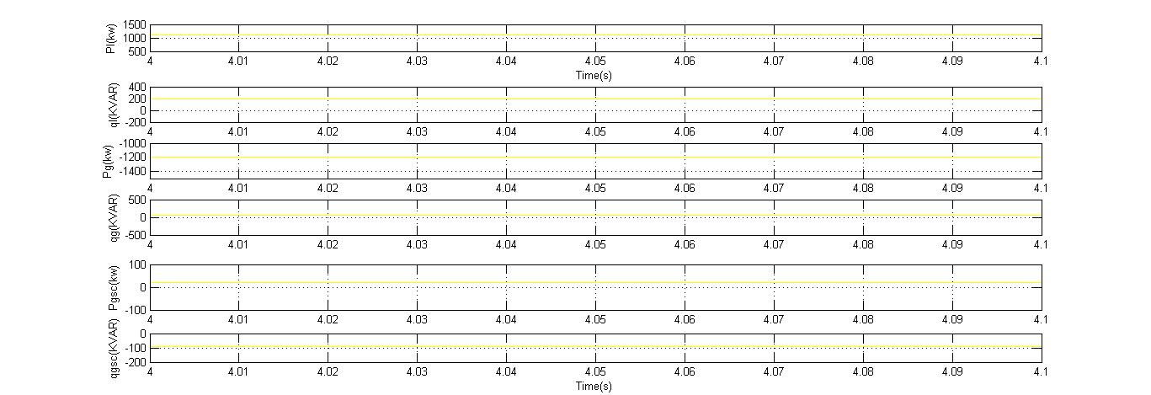

Slide 21
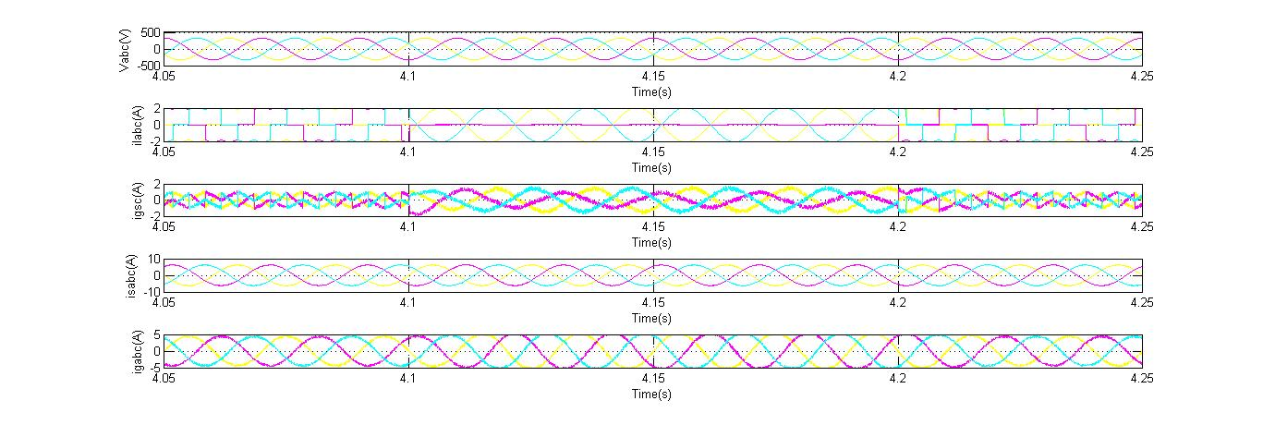
Dynamic performance of DFIG-based WECS for the sudden removal and application of local loads.

Slide 22
APPENDIX
DFIG: 3.7 kW, Rs= 1.32 ohm, Lls = 6.832 mH,
R2 =1.708 ohm, Llr = 6.832 mH, Rc = 419.646 ohm,
Lm =0.219 H, J = 0.1878 kg · m2, stator to rotor turns ratio Nr/Ns = 1/2,
stator rated rms current = 12 A, rotor rated rms current = 18 A.
2) DC machine: Ra = 1.3 ohms, Rf = 220 ohms, La = 7.2 mH, Lf = 7.5 mH, KΦ = 1.3314

Slide 23
CONCLUSION
The GSC control algorithm of the proposed DFIG has been modified for supplying the harmonics and reactive power of the local loads. In this proposed DFIG, the reactive power for the induction machine has been supplied from the RSC and the load reactive power has been supplied from the GSC. The decoupled control of both active and reactive powers has been achieved by RSC control. The proposed DFIG has also been verified at wind turbine stalling condition for compensating harmonics and reactive power of local loads.,

Slide 24
REFERENCES
[1] D.M.Tagare, Electric Power Generation the Changing Dimensions. Piscataway, NJ, USA: IEEE Press, 2011.
[2] G. M. Joselin Herbert, S. Iniyan, and D. Amutha, “A review of technical issues on the development of wind farms,” Renew. Sustain. Energy Rev., vol. 32, pp. 619–641, 2014.
[3] I.Munteanu, A. I. Bratcu, N.-A. Cutululis, and E. Ceang, Optimal Control of Wind Energy Systems Towards a Global Approach. Berlin, Germany: Springer-Verlag, 2008.
[4] A. A. B. Mohd Zin, H. A. Mahmoud Pesaran, A. B. Khairuddin, L. Jahanshaloo, and O. Shariati, “An overview on doubly fed induction generators controls and contributions to wind based electricity generation,” Renew. Sustain. Energy Rev., vol. 27, pp. 692–708, Nov. 2013.
[5] S. S. Murthy, B. Singh, P. K. Goel, and S. K. Tiwari, “A comparative study of fixed speed and variable speed wind energy conversion systems feeding the grid,” in Proc. IEEE Conf. Power Electron. Drive Syst. (PEDS’07), Nov. 27–30, 2007, pp. 736–743.

Slide 25
THANK YOU

